Slide 1
Battle of neighborhoods
Peer Graded Assignment
IBM Data Science Capstone

Slide 2
Introduction
Client wants to move to New York
New York is a multicultural city with five Boroughs
Client wants to move to either Manhattan or Queens
Important factors to consider are ”Indian Stores” in the area and “Nightclubs”
Indian Stores should be at a walking distance

Slide 3
Data
New York city data was obtained from the following link
https://geo.nyu.edu/catalog/nyu-2451-34572
Address for the areas were obtained using Google Maps
Venues were obtained using Foursquare API
Ratings of venues were obtained through Foursquare

Slide 4
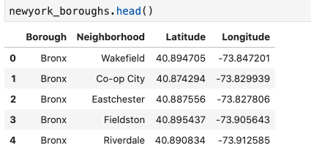
Methodology
Dataset was imported and loaded using wget command
Dataset was converted to a Dataframe

Slide 5
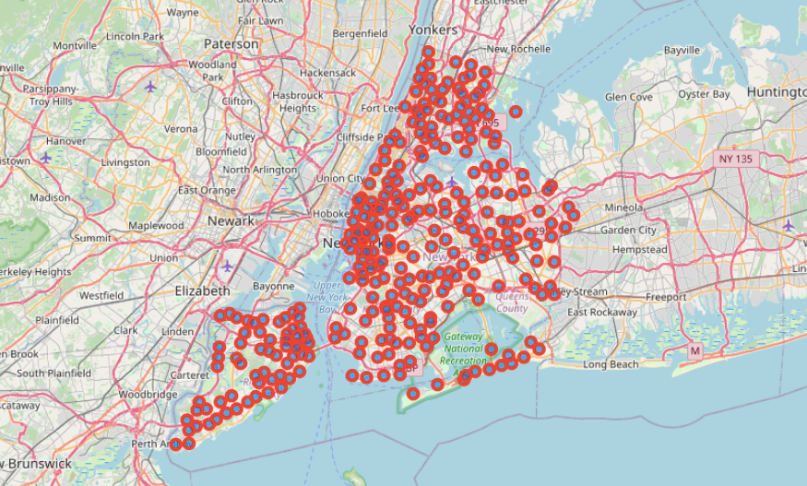
Methodology (Contd.)
Obtained Longitude and Latitude of New York City using Geopy Library
Visualized the Map of New York with Folium

Slide 6
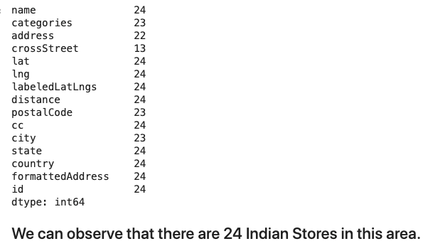
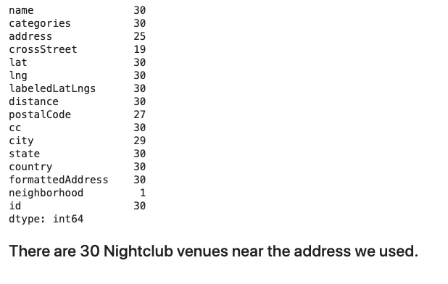
Results
Found 24 Indian Stores near the address in Manhattan area
Founds 30 Nightclubs near the address in Manhattan area

Slide 7
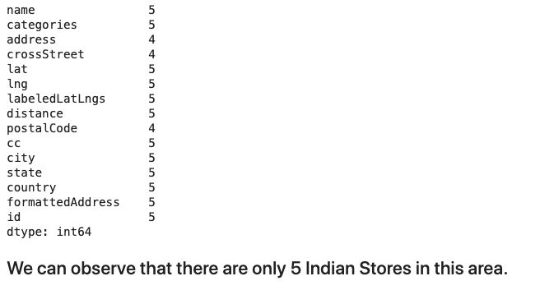
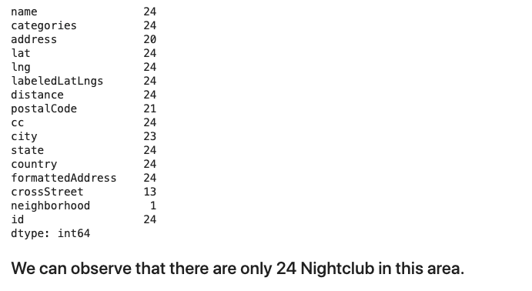
Results (Contd.)
Found 5 Indian Stores near the address in Queens Area
Found 24 Nightclubs near the address in Queens Area

Slide 8
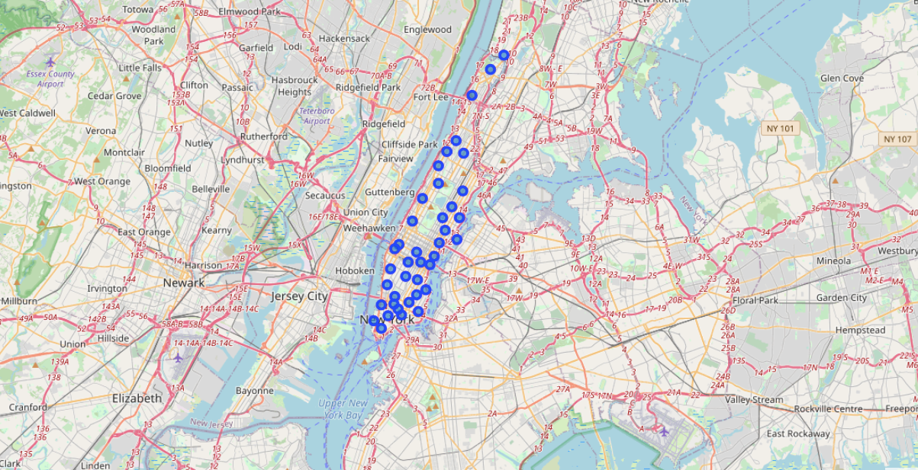
Discussion
Sliced the original dataframe to explore Manhattan
Loaded Foursquare Credentials
Set up a Query to find the Indian Stores near 1km of selected address
Found Rating of two random restaurants near the area
Set up a Query to find the Nightclubs near 5km of selected address

Slide 9
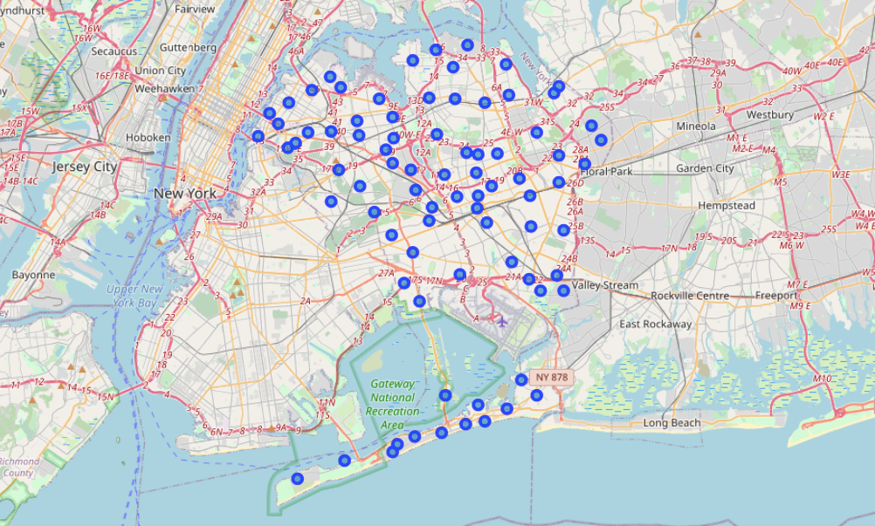
Discussion (Contd.)
Sliced the original dataframe to explore Queens
Loaded Foursquare Credentials
Set up a Query to find the Indian Stores near 1km of selected address
Found Rating of two random restaurants near the area
Set up a Query to find the Nightclubs near 5km of selected address

Slide 10
Conclusion
Client should move to Manhattan because
More Indian stores
More Nightclubs
Restaurant in Queens with high rating would also be suggested

